Slide 1
Nutrition and Wellness
EVERYTHING YOU NEED TO KNOW

Slide 2
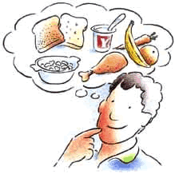
What is Nutrition anyways?
“Nutrition is the science that explores the myriad of chemical reactions that occur inside the cells of our bodies. From the combustion of carbohydrate for energy to the use of protein to heal a paper cut to the building of bone in a growing child, nutrition in action is something we don’t have to consciously think about.” (Evers, 2003)
Science behind consuming food
Also focuses on how diseases and certain conditions can be avoided with a healthy diet.

Slide 3
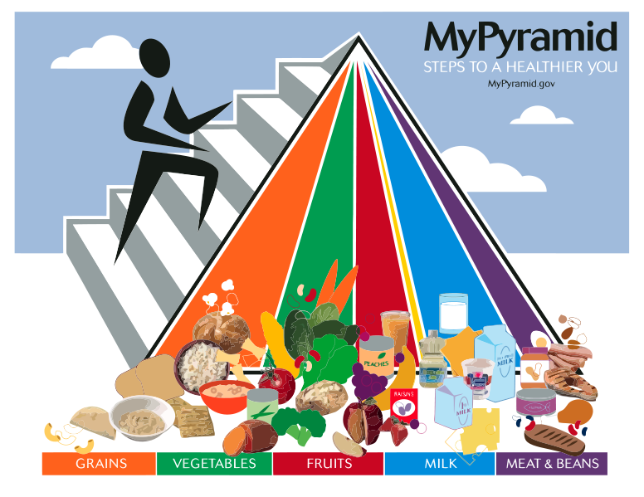

Slide 4
Food Guide Pyramid
Eat a variety of foods. A balanced diet is one that includes all the food groups. In other words, have foods from every color, every day
Eat less of some foods, and more of others. You can see that the bands for meat and protein (purple) and oils (yellow) are skinnier than the others.
That's because you need less of those kinds of foods than you do of fruits, vegetables, grains, and dairy foods.

Slide 5
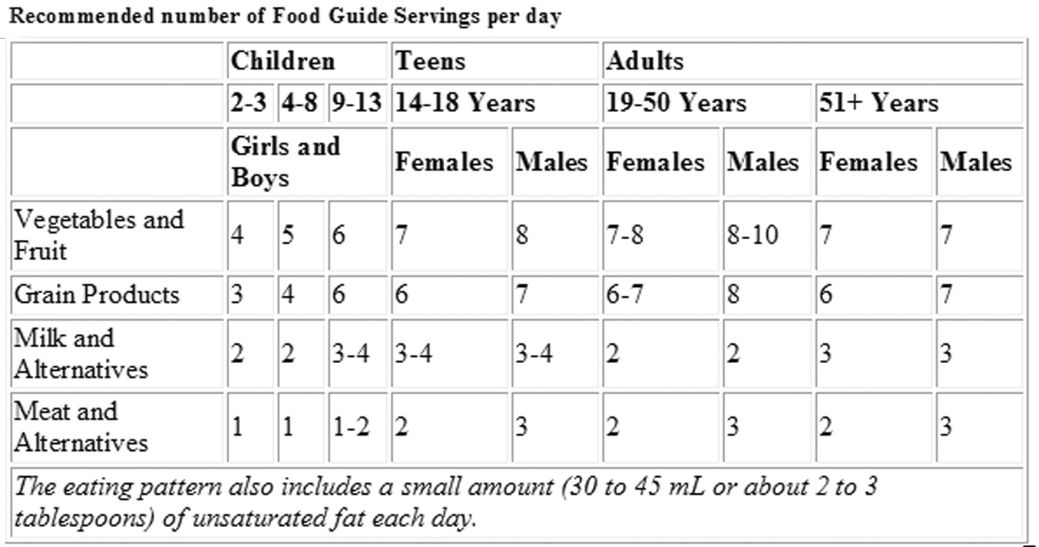

Slide 6
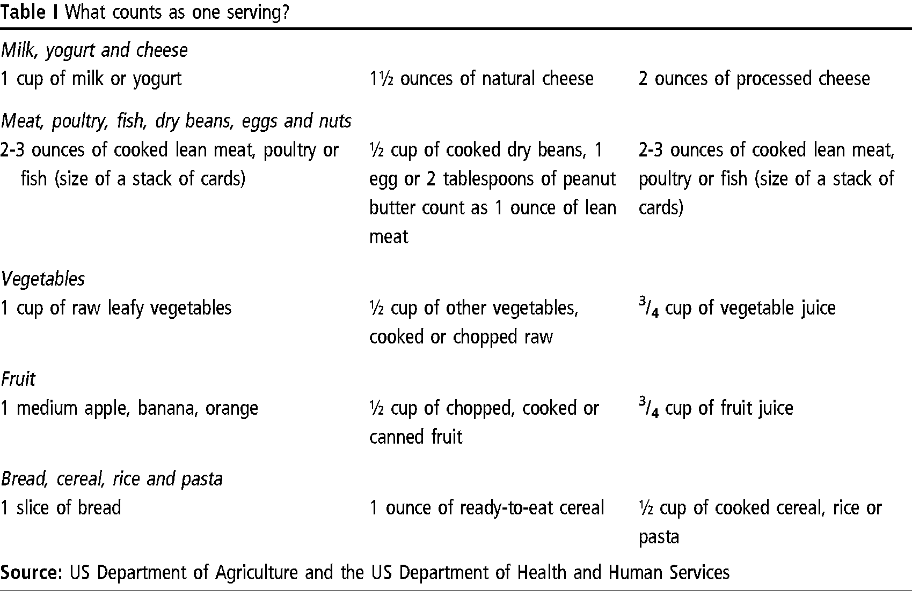

Slide 7
What are Nutrients?
Each group in the food pyramid provides certain nutrients
Nutrients help our body work at its best
Body needs a total of 40 nutrients that under six categories:
Carbohydrates, Protein, Fat, Vitamins, Minerals and Water
Eating foods from all food groups helps us get all of these nutrients

Slide 8
Grains
Key Nutrients: Carbohydrate, Fiber, Vitamin B, Iron
Carbohydrate is the body’s major source of energy.
B vitamins help in the body’s use of energy
Fiber aids the movement of food through the digestive tract
Iron carries oxygen in red blood cells and muscle cells

Slide 9
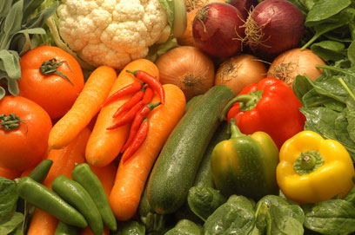
Vegetables
Key Nutrients: Vitamin A, Vitamin C, Folate, Iron, Magnesium, Fiber
Vitamin A helps maintain skin and mucous membranes and aids in vision
Vitamin C helps the body heal and fight infections
Folate is needed for healthy blood cells and is important for cell division, such as pregnancy and growth
Magnesium is found in bones and is important for muscle and nerve functioning

Slide 10
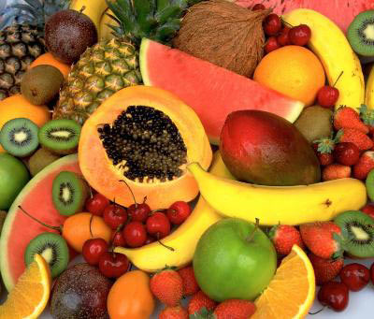
Fruits
Key Nutrients: Vitamin A, Vitamin C, Potassium, Folate, Fiber
Potassium maintains the heart beat, regulates body fluids, and is needed for muscle and nerve functioning

Slide 11
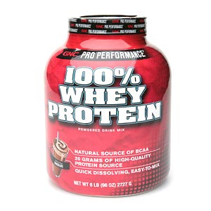
Protein
Key Nutrients: Protein, B vitamins, Iron, Zinc
Protein provides the building blocks needed for growth, replacement and maintenance of body tissues.
Zinc is necessary for healing, taste perception and growth

Slide 12
Dairy
Key Nutrients: Calcium, Riboflavin, Protein, Vitamin D
Calcium is needed for the development and maintenance of healthy bones and teeth
Roboflavin is a B vitamin that helps the body use energy
Vitamin D is a partner with calcium in building and maintaining strong bones

Slide 13
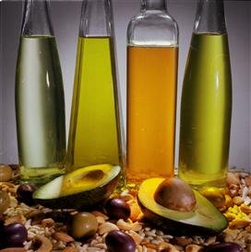
Fats
Key Nutrients: Simply carbohydrates, fat
Simple carbohydrates or sugars provide energy but few other nutrients
Fat is a source of energy and helps in the absorption of certain vitamins

Slide 14
Why Do you think this topic is important?
I want YOUR opinion

